Slide 1

Massive Data Breach at Tesla
Two former Tesla employees have been accused of stealing sensitive company data and leaking it to the public, resulting in a massive data breach that has rocked the electric vehicle giant.

Slide 2

What Happened: The Insider Threat
Tesla, a leading electric vehicle manufacturer, fell victim to a massive data breach orchestrated by two former employees. These insiders, with access to sensitive company information, exploited their positions to steal valuable trade secrets and customer data.

Slide 3

The Perpetrators: Two Former Tesla Employees
The massive data breach at Tesla was carried out by two former employees who stole sensitive company information. These individuals had previously worked at the electric vehicle manufacturer but had left the company under unknown circumstances.
The ex-employees leveraged their insider knowledge and access to Tesla's systems to illegally obtain confidential data, including trade secrets and strategic plans. Their actions put the company's competitive edge and reputation at risk.

Slide 4
Stolen Data: Sensitive Company Information
1
Trade Secrets
2
Customer Database
The former employees stole proprietary designs, manufacturing processes, and financial data - the crown jewels of Tesla's intellectual property.
They also accessed Tesla's customer database, including contact information and purchase histories of thousands of electric vehicle owners.
3
Future Product Plans
4
Financial Projections
Sensitive information about Tesla's upcoming models and new technologies was taken, giving rivals an unfair competitive advantage.
Confidential financial data, including sales forecasts, profit margins, and investment plans, was stolen and could be used to manipulate stock prices.

Slide 5

Breach Discovery: How it was Detected
1
Internal Monitoring
Tesla's security team detected suspicious activity on the company's internal systems, including unauthorized access to sensitive data.
2
Forensic Investigation
A thorough forensic investigation was launched to trace the data breach back to its source and identify the perpetrators.
3
Whistleblower Tip
One of the former employees felt remorseful and anonymously reported the data theft to Tesla, prompting the company to take immediate action.

Slide 6

Breach Impact: Consequences for Tesla
The massive data breach had severe consequences for Tesla. Sensitive information, including proprietary technology and trade secrets, was stolen by the former employees. This posed a significant risk to the company's competitive edge and ability to innovate.
The breach also eroded customer trust and damaged Tesla's reputation as a leader in the electric vehicle industry. The incident highlighted the importance of robust cybersecurity measures and the need to closely monitor employee activities to mitigate insider threats.

Slide 7
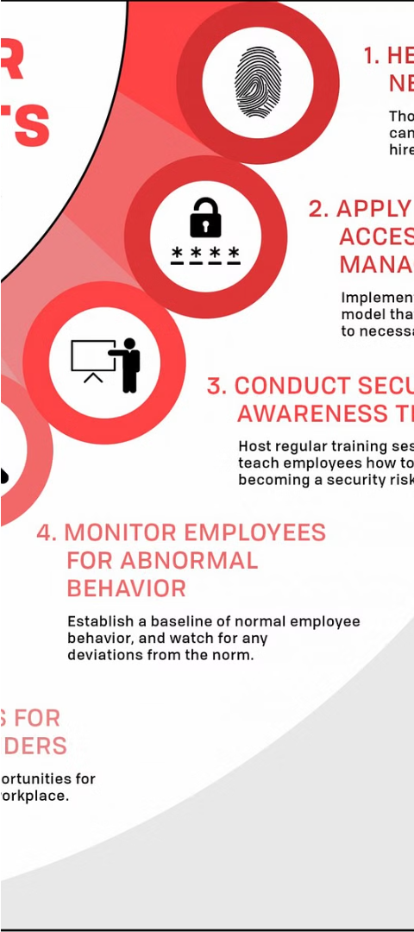



Insider Threat Risks: Lessons Learned
Underestimating Insider Threats
Many organizations fail to recognize the significant risks posed by trusted insiders, often focusing solely on external threats.
Lack of Visibility
Without proper monitoring and access controls, malicious insiders can operate undetected, freely accessing and exfiltrating sensitive data.
Inadequate Security Policies
Weak or outdated security policies leave organizations vulnerable to insider threats, highlighting the need for comprehensive, adaptive measures.

Slide 8
Cybersecurity Measures: How to Prevent Future Breaches
Employee Training
Access Controls
Monitoring and Alerting
Data Encryption
Implement robust access controls, including multi-factor authentication and role-based permissions, to limit data access to only those who require it.
Ensure all employees receive comprehensive cybersecurity training to recognize and report potential threats, such as phishing attempts and unauthorized data access.
Deploy advanced monitoring solutions to detect suspicious user activities and data transfers, triggering real-time alerts to the security team.
Encrypt all sensitive data, both at rest and in transit, to protect it from unauthorized access in the event of a breach.

Slide 9



Importance of Employee Monitoring: Detecting Insider Threats
Monitoring Systems
Data Analytics
Dedicated Team
Comprehensive employee monitoring solutions can detect suspicious activity, such as unauthorized data access or transfer, in real-time.
Advanced data analytics can spot anomalies and identify potential insider threats by analyzing user behavior patterns and access logs.
Maintaining a dedicated cybersecurity team to proactively monitor for and respond to insider threats is crucial for protecting sensitive data.

Slide 10
Conclusion: Protecting Against Insider Threats
Comprehensive Security Measures
Continuous Monitoring
Regularly reviewing user activities, detecting anomalies, and investigating suspicious behaviors are crucial for early detection of insider threats.
Implementing robust security controls, access restrictions, and employee monitoring can help mitigate the risk of insider threats.
Promote Security Culture
Incident Response Plan
Fostering a security-aware culture, providing security training, and encouraging employee engagement can empower the workforce to be vigilant against insider threats.
Developing a well-defined incident response plan can help organizations quickly contain the impact and minimize the damage from an insider breach.

